Slide 1

Coding with Intelligence
Presented by:
John Dohoney, Jr.
Alexandra Deany
Adam Lubenow
SDP, US West

Slide 2

What does Copilot do for you
Prompting
How do you squeeze the most out of Copilot
Prompting Lab
Co-Pilot Labs

Slide 3
January 25 - Day 1 (All times are PST)
(First Half of Morning)
6:05 – 6:25 - Agenda Overview
6:25 – 8:00 - Copilot Preso
Basic Prompting and DALL-E Prompting Exercise,
Advanced Prompting
CoPilot with RAG
Visual Studio - Walkthrough
8:00 – 8:45 – Lab 1 – Xunit – Walkthrough/HandsOn Lab
8:45 – 9:00 - Break
9:00 - 11:00 - Lab 2a/2b - DotNet /Angular Lab HandsOn
(Option to work with Lab 2b-Angular, Lab 2c-Express, or Lab 2d-Blazor) – Pick one
11:30 – 12:00 Lunch

Slide 4
January 25 – Day 1 (Second Half of Day)
12:00 - 1:30 Lab 3 - Postman/Newman API testing of DOTNET and
Lab 4- API Design First (Open API/Swagger Lab)
1:30 - 2:30 Labs
-Unit Testing – Lab 5a - Jasmine (JS), Lab 5b - XUnit
- Lab 6 - Dot Net Azure Cognitive Services Lab (C#)
2:30-3:00 Questions and Feedback

Slide 5
January 26 - Day 2
6:00 - 8:00 – Catch up on labs not completed on Day-1 (or do optional Homework Labs)
8:30 - 12:30 - Working sessions with Optimal Blue applications / end user stories
(work out your lunch during this time)
12:30 – 2:00 Your Demos from CoPilot Use with your stories or tasks

Slide 6

Prompts by John Dohoney
Image Creation by DALL-E
https://www.bing.com/images/create

Slide 7

co·pi·lot (ˈkōˌpīlət/) a qualified pilot who assists or relieves the pilot but is not in command
The design pattern for Microsoft/Github AI tools

Slide 8

Tips for Using GitHub Copilot
Know that it's a copilot, not an autopilot
Copilot augments your productivity, but you remain in the driver's seat
Use Copilot as a source of inspiration and guidance, then use your own creativity, logic, and judgment before acting or finalizing
Copilot is a co-creator, not a solo artist!
Copilot is an augmentation, not an automation
It is designed to help you, not to replace you
Always review and edit the outputs before using them for your purposes
Notes:
Having the right expectations and mindset is essential for using M365 Copilot. It's a digital assistant that uses human language, but it doesn't think, feel, or learn. It's a powerful tool, but it needs context and clear instructions to help you. Copilot is a copilot, not an autopilot - it augments your productivity, but you remain in the driver's seat. It's an augmentation, not an automation - it is designed to help you, not to replace you. Always review and edit the outputs before using them for your purposes. Original Content: Mindset Having the right expectations and mindset is important to your first interactions with M365 Copilot. Copilot is a digital assistant that uses human language, but it doesn t think, feel, or learn. Its context about your needs is limited to your current conversation. M365 Copilot is a very powerful tool, but it can t read minds. Think of M365 Copilot as the world s smartest personal assistantintern [KS10] on their first day. Your assistantIt [KS11] iis very intelligent and capable but it doesn t know how you think, so the more context and clarity you give it, the better it can help youwill your need context and clear instructions in order to best help you[KS12] .. You[MY13] [ME14] will need to state your goal[KS15] , turn the implicit into explicit, and organize work into multiple steps. It s also meant to be iterative, so you work alongside the AI Copilot works best when you give it the chance to build on itself, so don t hesitate to let it know when you were looking for something different or more. This is a new skill and there is a learning curve. To harness its full potential, embrace the right mindset. Here s how to approach using M365 Copilot to are essential our tried and tested tips to unleash M365 Copilotit's magic: Know that it s a copilot, not an autopilot. Copilot augments your productivity, but you remain in the driver s seat. The LLMs and the data Copilot uses have limits. Use Copilot as a source of inspirati

Slide 9

Collaborating with Copilot for Better Results
Copilot is a co-creator, not a solo artist - collaborate with it, provide feedback, and iterate on the results.
Use your own creativity, logic, and judgment to improve the outputs.
Optimize the ingredients of your prompt to Copilot.
Copilot is a learn-it-all, not a know-it-all - be open to learning and experimenting.
Use friendly language like you would with a colleague to get better results.
Be polite - using polite professional language helps improve quality.
If at first you don't succeed, try again - embrace your learning curve and remain flexible.
Notes:
Copilot is best used when you collaborate with it, provide feedback, and iterate on the results. You should also use your own creativity, logic, and judgment to improve the outputs. It's important to optimize the ingredients of your prompt to Copilot. The model is learning from your inputs, so be open to learning and experimenting with Copilot and try different things to see what works best. Use friendly language like you would with a colleague to get better results. Be polite and use polite professional language to help improve quality. If at first you don't succeed, try again. Embrace your learning curve, remain flexible, and try more than one approach. Original Content: Copilot is a co-creator, not a solo artist. It works best when you collaborate with it, provide feedback, and iterate on the results. You should also use your own creativity, logic, and judgment to improve the outputs. <should we point to the WTI here on the skills needed for AI Aptitude?>Use the best ingredients. You ll unlock more value when you optimize the ingredients of your prompt to Copilot (see next section) Copilot is a learn-it-all, not a know-it-all. The model is learning from your inputs. You should also be open to learning and experimenting with Copilot and try different things to see what works best.[KS17] [ME18] Copilot is a partner. Use friendly language like you would with a colleague to get better results. Rude, abusive, or slang language can cause confusion in the large language model (LLM).[KS19] [ME20] [MY21] Be polite. Using polite professional language helps improve quality, not because Copilot has feelings, but because the LLMs responses reflect the probability of how a human would respond. If at first you don t succeed, try again. Copilot is based on stable yet constantly evolving technology. Embrace your learning curve, remain flexible, and try more than one approach.

Slide 10

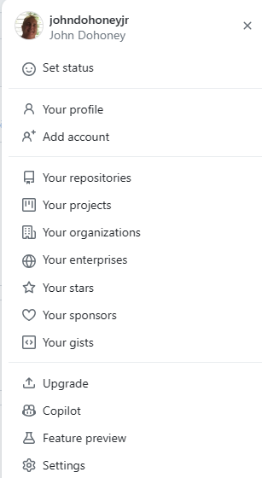
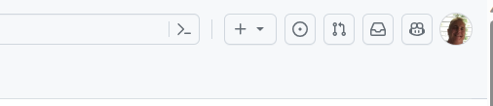
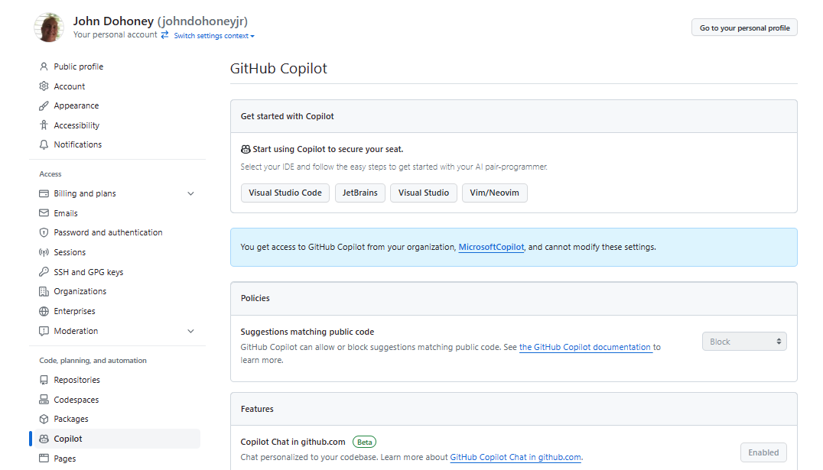


CoPilot Annoyances
Sometimes it stops generating based on setting in your GitHub Profile (or worse case in your Organizations Profile)
Assuming your Org does not block public code, you can change this going to your settings | Copilot from the Upper Left Menu on GitHub

Slide 11
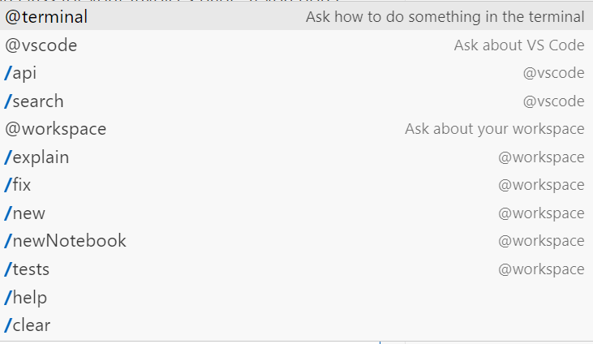
CoPilot Fast Lane
You can ask CoPilot general programming questions, or chat with the following agents which have specialized expertise and can perform actions:
@workspace - Ask about your workspace
/explain - Explain how the selected code works
/tests - Generate unit tests for the selected code
/fix - Propose a fix for the problems in the selected code
/new - Scaffold code for a new workspace
/newNotebook - Create a new Jupyter Notebook
@vscode - Ask about VS Code
/search - Generate query parameters for workspace search
/api - Ask about VS Code extension development
@terminal - Ask how to do something in the terminal
To have a great conversation, ask CoPilot questions as if it was a real programmer:
Show CoPilot the code you want to talk about by having the files open and selecting the most important lines.
Make refinements by asking the agent follow-up questions, adding clarifications, providing errors, etc.
Review your suggested code and tell copilot about issues or improvements, so I can iterate on it.

Slide 12
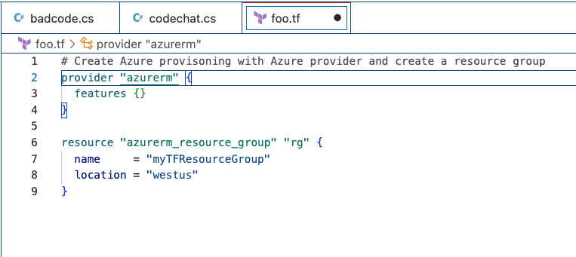




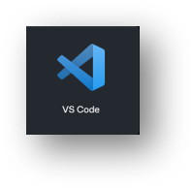

OpenAI Codex
Prompting
Be specific
Be clear about what you want done
The more information, the better the result
Operates off plain English – no special syntax
Context
Prompts and Suggestions

Slide 13
Prompting – Best Practices
Set the stage with a High-Level Goal
This is most helpful if you have a blank file or empty codebase. In other words, if GitHub Copilot has zero context of what you want to build or accomplish, setting the stage for the AI pair programmer can be really useful. It helps to prime GitHub Copilot with a big picture description of what you want it to generate—before you jump in with the details.
When prompting GitHub Copilot, think of the process as having a conversation with someone: How should I break down the problem so we can solve it together? How would I approach pair programming with this person?

Slide 14
Prompting – Best Practices
Make your ask simple and specific. Aim to receive short output from GitHub Copilot
Once you communicate your main goal to the AI pair programmer, articulate the logic and steps it needs to follow for achieving that goal. GitHub Copilot better understands your goal when you break things down.
(Imagine you’re writing a recipe. You’d break the cooking process down into discrete steps–not write a paragraph describing the dish you want to make.)
Let GitHub Copilot generate the code after each step, rather than asking it to generate a bunch of code all at once.

Slide 15
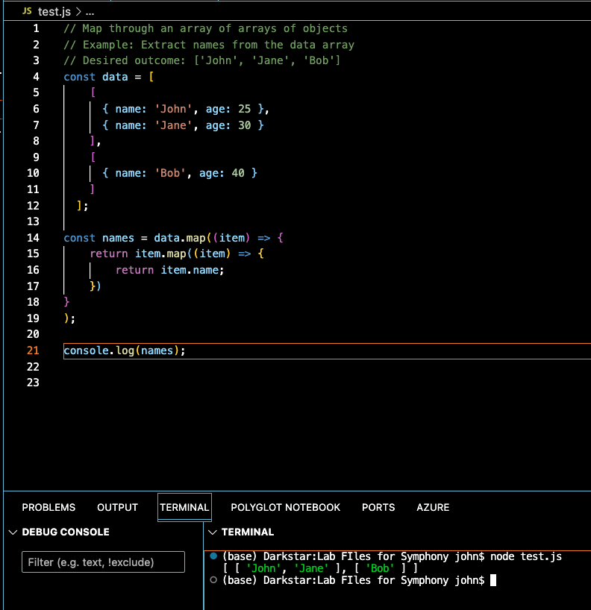
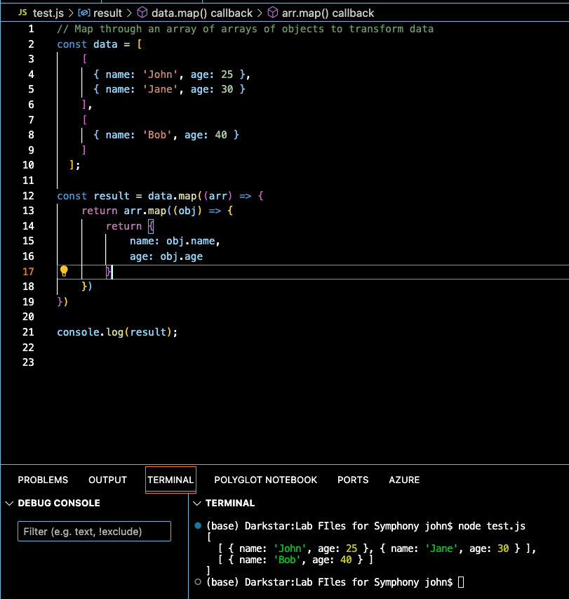
Prompting – Best Practices
Give GitHub Copilot an example or two
Learning from examples is not only useful for humans, but also for your AI pair programmer.

Slide 16
Prompting – Basics
Experiment with your prompts.
Just how conversation is more of an art than a science, so is prompt crafting. So, if you don’t receive what you want on the first try, recraft your prompt by following the best practices in the previous slides.
Keep a couple of relevant tabs open
No exact number of tabs is documented that you should keep open to help GitHub Copilot contextualize your code, but from my experience, I found that one or two is helpful.
GitHub Copilot uses a technique called neighboring tabs that allows the AI pair programmer to contextualize your code by processing all of the files open in your IDE instead of just the single file you’re working on. However, it’s not guaranteed that Github Copilot will deem all open files as necessary context for your code.
Use good coding practices.
Provide descriptive variable names and functions. Follow consistent coding styles and patterns. I’ve found that working with GitHub Copilot encourages me to follow good coding practices learned throughout my development career.

Slide 17




What does Copilot do best
Code Conversion
Pair Programming
Test Case Coverage advisor
Refactoring Assistant

Slide 18

DALL-E Lab

Slide 19
Prompting Exercise – With Dall-E
What is DALL-E
DALL-E is an image generation model developed by OpenAI that can generate unique images from textual descriptions
Odd Name?
DALLE stands for “DAll-E”, which is a combination of the words “Dali” and “Wall-E”. The name is a nod to surrealist artist Salvador Dali and the Pixar movie character Wall-E, and reflects the combination of language and image processing capabilities of the model.
How does it work?
DALL-E uses a transformer-based neural network architecture that combines both language and image processing techniques. It generates images by decomposing the textual description into a set of image features, which are then used to generate the final image.

Slide 20

Prompting Exercise – Instructions
Go To: https://www.bing.com/images/create
The Idea is to try your hand at prompting and evolve your design with added specificity to your prompts.
My Example:
Prompt: “pencil drawing of a remote island on a sunny day”

Slide 21

Prompting Exercise – Instructions
Now, evolve your drawing:
Prompt: pencil drawing of a remote island on a sunny day with sharks swimming around the island
Notice the Hallucination… (Do sharks Fly? )

Slide 22

Prompting Exercise – Instructions
Further evolve your drawing:
Pretend you are Escher. pencil drawing of a remote island on a sunny day with sharks swimming around the island in the water
I did not get recursion, but I did get reflection – pretty cool

Slide 23

Prompting Exercise – Conclusions
What can we conclude from this exercise?
How did prompting change your images?
How do you think this will work with code generation?
pretend you are Escher. watercolor of a remote island on a sunny day with sharks swimming around the island in the water

Slide 24

Prompt Engineering - Review
Notes:
SPEAKER NOTES: Lets Review, Ever wonder what a 'prompt' is or how to craft a really good one? Well, we're about to find out! We'll uncover the magic behind prompt engineering, why it's a game-changer, and sprinkle in some cool techniques. By the end, you'll know all the building blocks to become a prompt pro!

Slide 25

What is a Prompt?
In the context of Copilot, a prompt is a piece of code or natural language description that is used to generate code suggestions. It is the input that Copilot uses to generate its output. - Copilot
Notes:
Prompting in GitHub Copilot refers to the way users communicate their coding intentions or requirements to the AI. Effective prompting ensures that Copilot understands the context and offers accurate code suggestions. It's akin to asking a seasoned developer for help – the clearer and more specific your question, the more targeted and useful their response. Techniques like role prompting, where Copilot is given a specific 'role' to play (e.g., a front-end developer), can further refine the generated outputs. By mastering the art of prompting, developers can harness the full potential of Copilot, making their coding process smoother and more efficient.

Slide 26
What is Prompt Engineering?
Prompt engineering is the process of designing and creating high-quality prompts that can be used to generate accurate and useful code suggestions with Copilot. - Copilot
Notes:
Prompt Engineering is the strategic crafting of user inputs to guide the AI towards producing desired code outputs. Just as a well-framed question can lead to a more precise answer, careful prompt engineering ensures that Copilot provides more relevant and accurate code suggestions. This involves techniques like role prompting, contextual detailing, and iterative refinement, which collectively enhance the interaction between the developer and Copilot. A nuanced understanding of prompt engineering allows developers to optimize their use of Copilot, ensuring they get the most out of this advanced coding assistant. It is basically tips and tricks to help make your prompts more reliable. Most of the time when you have traditional prompts or one off prompts that you use and throw away, you don’t really need prompt engineering. But once you introduce this into production, you want this to be much more reliable. You want to be able to predict how that response will be formatted and look.

Slide 27

Why is Prompt Engineering Important?
Maximizes utility of Copilot
Minimizes repeated iterations
Determines code suggestion quality
Skill prompts guide Copilot to understand context & nuances
Refined interactions reduces misunderstandings
Notes:
SPEAKER NOTES: Prompt engineering is crucial in relation to Copilot because it determines the quality, accuracy, and relevance of the code suggestions the tool provides. GitHub Copilot, powered by AI, relies heavily on the input it receives to produce desired outputs. By skillfully crafting prompts, developers can guide Copilot to better understand the context and nuances of their coding requirements. This refined interaction reduces the likelihood of misunderstandings, minimizes the need for repeated iterations, and maximizes the utility of Copilot, ensuring developers get the most out of this advanced coding assistant.

Slide 28




Techniques
Zero-Shot Prompting
One-Shot Prompting
Few-Shot Prompting
No Example
One Example
Handful of Examples
Notes:
SPEAKER NOTES: In the realm of GitHub Copilot, Zero-shot, One-shot, and Few-shot prompting refer to guiding the AI with varying levels of examples. Zero-shot prompting doesn't provide any prior examples, expecting Copilot to understand and generate relevant code purely from the given task description. One-shot prompting provides a single example to set the context, assisting Copilot in generating a similar outcome. Few-shot prompting involves offering multiple examples to establish a clearer pattern for the desired code output. By understanding these techniques, developers can better instruct Copilot, ensuring more accurate and context-aware code suggestions.

Slide 29
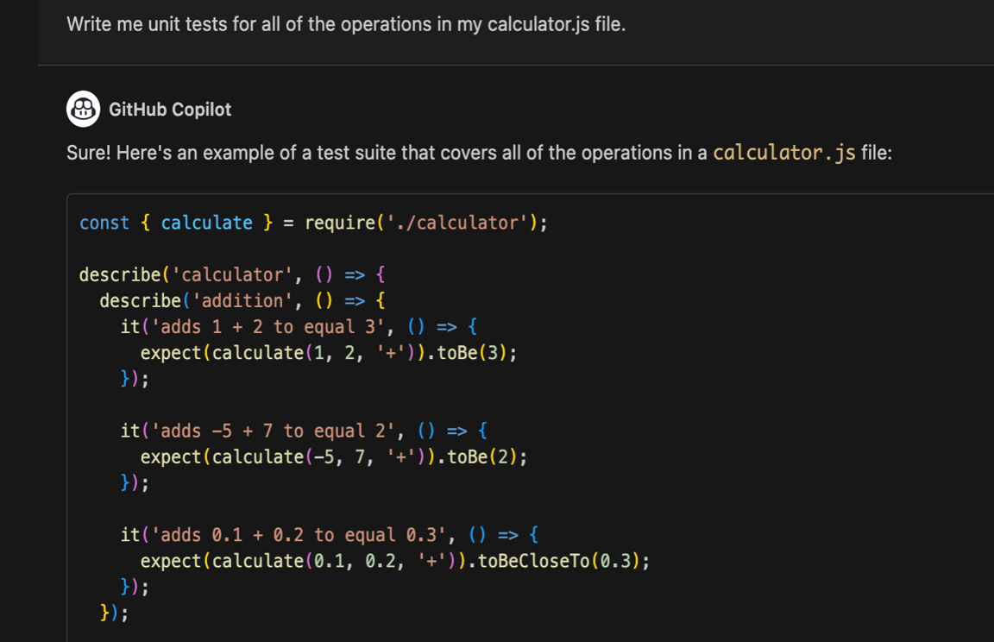
Zero-Shot Programming
with Copilot
Techniques
Notes:
SPEAKER NOTES: Now let’s take a look at this technique in use with GitHub Copilot. For example, we sought Copilot's assistance to craft unit tests for a file managing our project operations. After it presented its suggestions, we realized the test formats didn't align with our preferred style. This highlighted the importance of being clear with our prompts and maybe even providing Copilot with a pattern we're comfortable with, to get the desired output.
Write me unit tests for all the operations in my calculator.js file

Slide 30
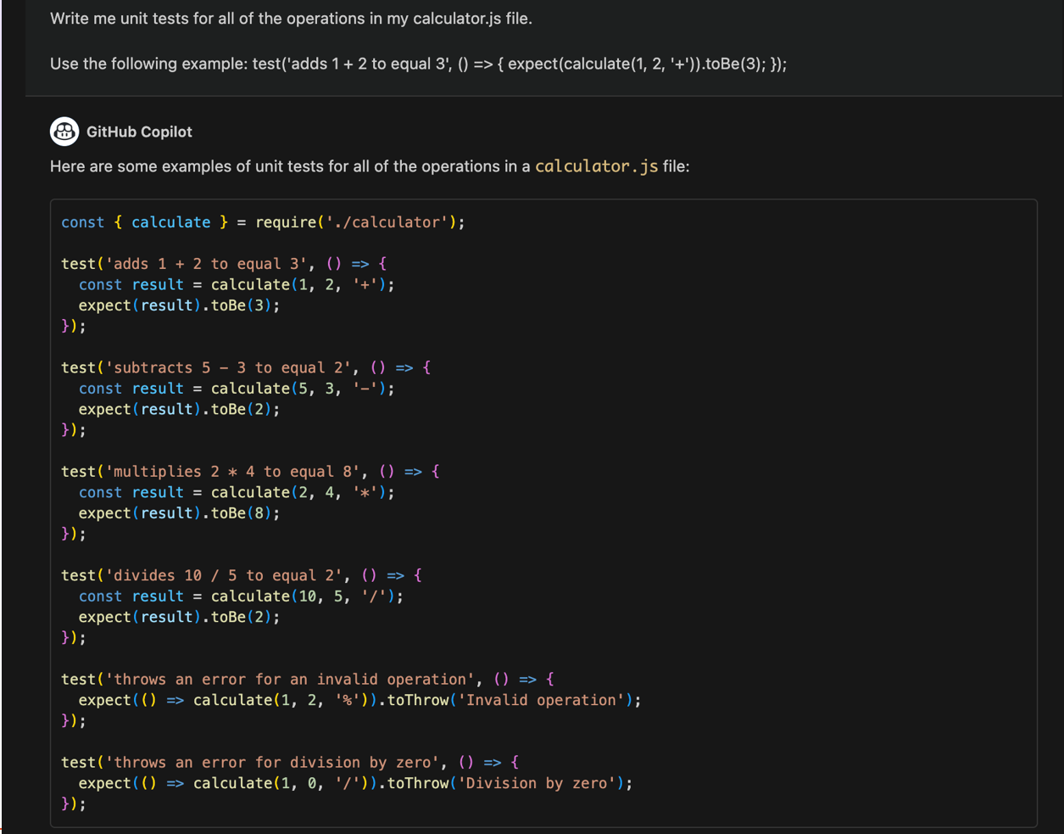
One-shot Programming
with Copilot
Techniques
Notes:
SPEAKER NOTES: So as you can see in our prompt to Copilot Chat, our prompt is nearly identical except this time we have provided an additional line that has an example of a test pattern that we want. By just giving that single example, Copilot immediately adapted and offered improved test suggestions that perfectly matched our style. This showcases the efficiency of one-shot programming: with just one well-placed example, Copilot could instantly align with our preferences, offering us practical results that streamlined our work.
Write me unit tests for all the operations in my calculator.js file.
Use the following example: test(‘adds 1 + 2 to equal 3’, () => ( expect(calculate(1, 2 ‘+’)).toBe(3); });

Slide 31
Cornerstones of Prompting
Control Output Verbosity
Chaining Prompts
Provide Examples
Evaluate Quality
Give Direction
Format your Response
Notes:
SPEAKER NOTES: Providing Examples - Utilizing Copilot effectively often hinges on how we communicate our needs. For instance, providing examples can significantly enhance the reliability of the output. These examples can be positive illustrations of what we desire or even instances of what we wish to avoid.
Giving Direction - This act of giving direction can be likened to seeding words within Copilot. But while guidance is essential, it's crucial not to stifle Copilot's creativity excessively. To illustrate, consider the stark difference between a generic prompt and one imbued with clear direction.
Formatting your Responses - Another pivotal aspect is how we expect our responses. By specifying our desired format, like wanting an HTML file, a list, or a function, we can control and anticipate the kind of output Copilot provides. Setting precedents or examples for expected responses can be invaluable here.
Evaluate the Quality - It's not just about obtaining a response, but about evaluating its quality. This iterative process involves refining prompts, testing for reliability, and tweaking keywords to diversify or narrow down results. If you find the outputs too monotonous or not aligned with expectations, adjusting parts of your prompt can be the key. A continuous evaluation will help fine-tune Copilot's performance, ensuring it aligns with our needs.
Chaining prompts can elevate the sophistication of tasks Copilot assists with. By asking sequels or follow-up questions, which contain context from prior interactions, we can seamlessly integrate multiple AI responses to achieve more intricate objectives. Lastly, you have the ability to control your Output Verbosity - You can dictate your output length and the verbosity just by including it in your prompt.

Slide 32

Prompt Engineering
Zero-Shot Prompting
One-Shot Prompting
Few-Shot Prompting
Notes:
SPEAKER NOTES:
DEMO Prompt 1
Zero-shot “generate tests for stack and node classes“
One-Shot “Write me unit tests for all the operations in stack and node classes in the file Use the following example: it('should return null when popping from an empty stack', () => {
const poppedValue = stack.pop();
expect(poppedValue).toBeNull();
});”
DEMO Prompt 2 -
Zero-shot “Can you create an HTML calculator for me?“
One-Shot “Can you create an HTML calculator for me? Use the following example: <!DOCTYPE html>
<html>
<head>
<title>Calculator</title>
<link rel="stylesheet" href="style.css">
</head>
<body> “
DEMO Prompt 3
Zero-shot “Can you write me the code for a snake game?“
One-Shot “Can you write me the code for a snake game?
Example: Ensure that there is a leaderboard mechanic“

Slide 33
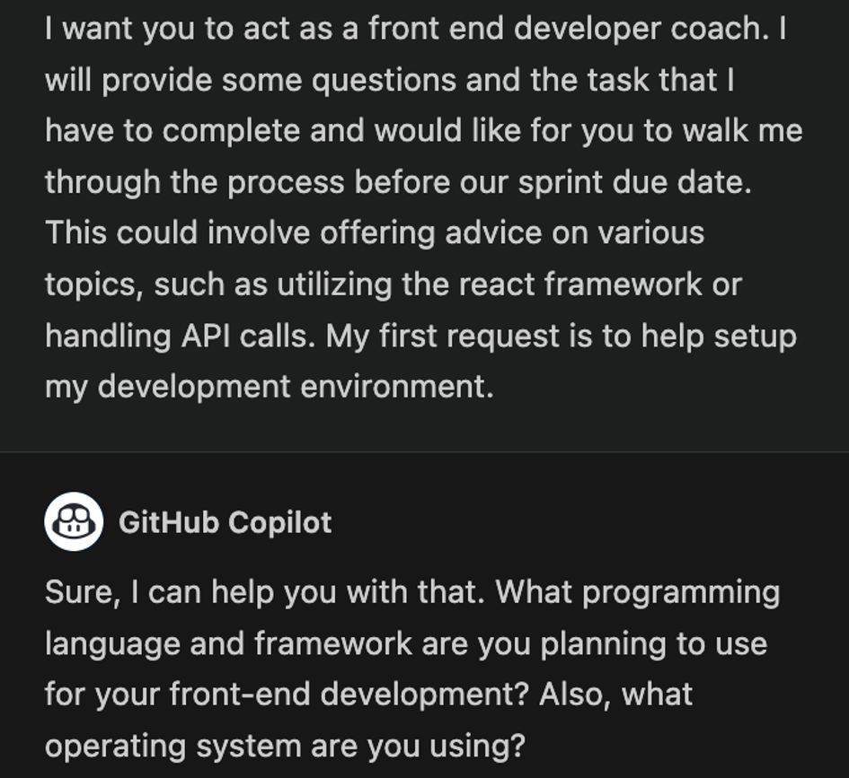
Role Prompting
Use copilot to assume a role during a task
Focus to improves results
Improves results by narrowing the AI’s focus
Enhanced Results
Notes:
SPEAKER NOTES: Role Prompting - Here we discuss having Copilot take on a role when completing a task.
If you take a look at the example in the slide, here we have a prompt that states "I want you to act as a front end developer coach. I will provide some questions and the task that I have to complete and would like for you to walk me through the process before our sprint due date. This could involve offering advice on various topics, such as utilizing the react framework or handling API calls. My first request is to help setup my development environment."
This tends to improve the results because it focuses the AI model on only the information it would have in that current role. It takes on that persona and alters the way that the model would present information.
I am going to paste in the chat a resource that has all kinds of pretty neat Role Prompting prompts that you can bookmark and potentially utilize at a later point.
https://github.com/f/awesome-chatgpt-prompts
Combining Role prompting with asking for context can yield even better results.
For example: "If I have not given you enough information, please let me know what information is missing to make a better decision."

Slide 34
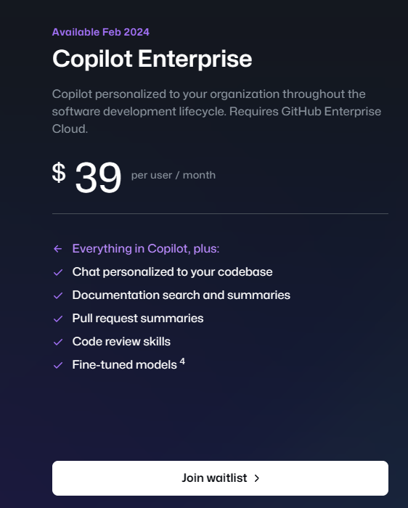
Improving CoPilot
RAG stands for Retrieval Augmented Generation. It is a technique used in GitHub Copilot to add context from a user's entire repository to the prompt.
This helps Copilot to provide more accurate and relevant code suggestions and completions.
RAG uses a retrieval model to search through the user’s repository and find relevant code snippets, which are then used to augment the generation model’s input.
GitHub Copilot · Your AI pair programmer

Slide 35
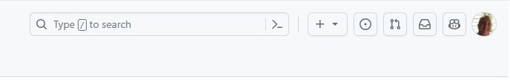
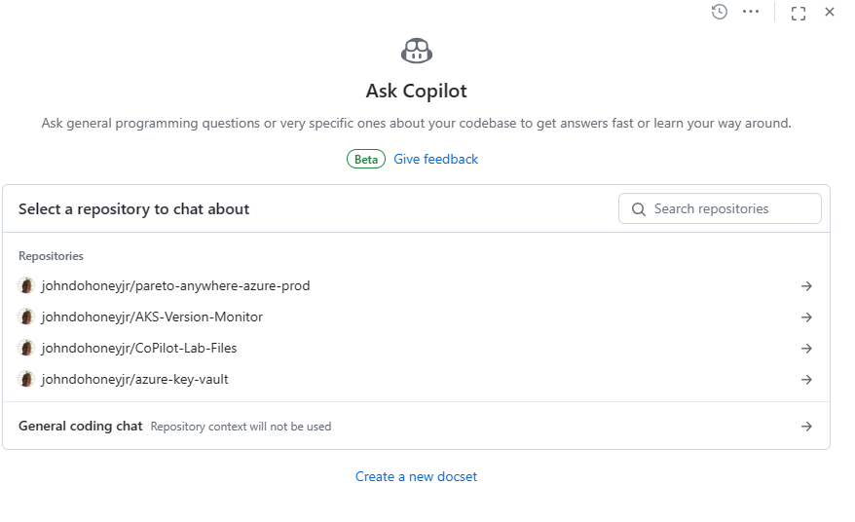
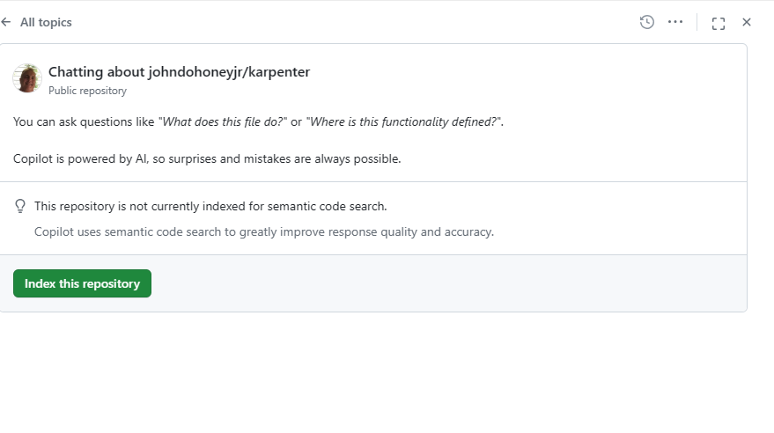

Indexing your Repo
Notes:
Live Demo on: johndohoneyjr/karpenter: AKS Karpenter Provider (github.com)

Slide 36
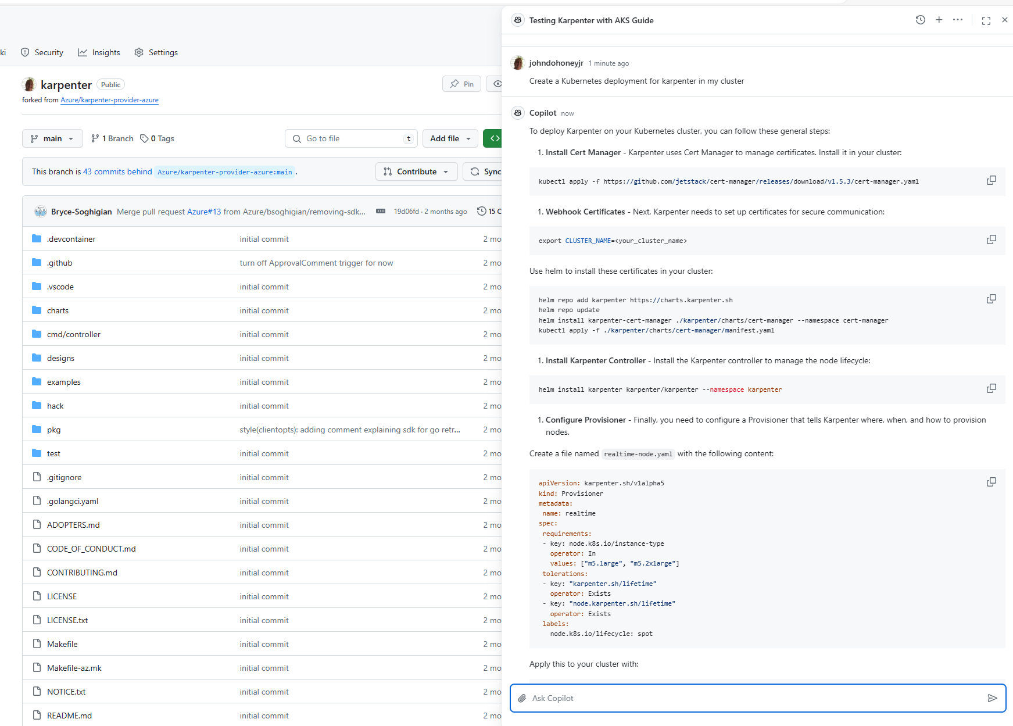
Query your Repo

